Slide 1

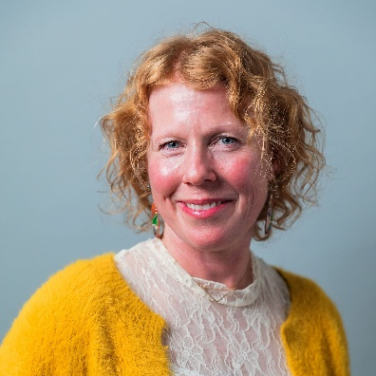
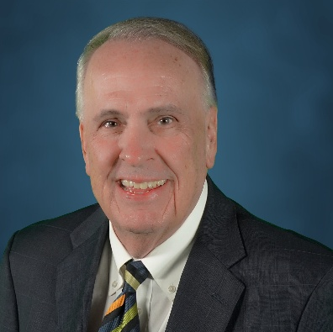
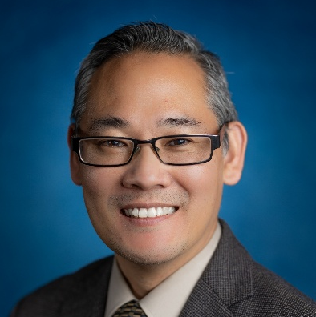
WELCOME
OC HUNGER ALLIANCE
COMMUNITY CONVENING ON THE LOCAL IMPACTS OF HR1
Kristin Hilleman
Director, Food and Nutrition Services Capistrano Unified School District
Michael Hunn
Chief Executive Officer
CalOptima Health
An Tran
Director, Social Services Agency
County of Orange

Slide 2
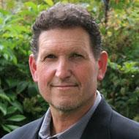
Mike is a seasoned food industry professional with over 30 years of experience and President and co-founder of TJM, Inc., founded in 1993. His background spans restaurant, catering, and concession operations, as well as sales and marketing for major food service partners.
In 2013, he launched the Waste Not OC food recovery pilot, which became one of the nation’s leading models. As Executive Director from 2016, he guided its growth and rebrand to Abound Food Care, where he now serves as CEO, leading cross-sector collaborations to build a more efficient and resilient food system.
He is a founding member of and serves on the Steering Committee of the OC Hunger Alliance.
Mike Learakos
Chief Executive Officer
Abound Food Care

Slide 3








About the OC Hunger Alliance (OCHA):
Founded in 2020 by Second Harvest Food Bank, Community Action Partnership of Orange County’s OC Food Bank (CAP OC) and Abound Food Care.
Guided by a cross-sector Steering Committee including 2-1-1 Orange County (a key service of Orange County United Way), CalOptima Health: A Public Agency, Meals on Wheels of Orange County, Orange County Grantmakers, and the County of Orange Social Services Agency (SSA).

Slide 4
OCHA SIX PILLARS: SHARED AGENDA
Coordinated Logistics
Enhanced Services
Enhanced Procurement
Food Recovery
Client Choice
Cal Fresh Participation

Slide 5
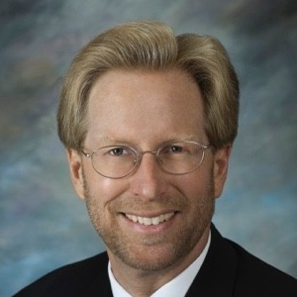
Mark Lowry is Director of the OC Food Bank, a program of the Community Action Partnership of Orange County, a private non-profit charity.
During Mark’s tenure, food distribution expanded from 2 million to over 26 million pounds annually, serving more than 300,000 people each month. In 2020, over 63 million pounds of food were distributed during the COVID response, and Mark secured funding to launch the OC Diaper Bank.
Mark was recognized as one of Orange County’s 100 Most Influential People, in 2015, 2019 and 2020.
As an advocate, he works with officials at all levels on issues of social and economic justice and has served as President of the California Association of Food Banks.
He is a founding member of and serves on the Steering Committee of the OC Hunger Alliance.
Mark Lowry
Director, OC Food Bank
Community Action Partnership of Orange County

Slide 6

With over 26 years of service to the County of Orange, Mr. An Tran brings extensive leadership experience across four County departments, including the Social Services Agency, OC Waste & Recycling, the County Executive Office, and the OC Health Care Agency.
He has served as the Director of the Social Services Agency (SSA) since 2022.
An is also a member of the OC Hunger Alliance Steering Committee.
An Tran
Director, Social Services Agency
County of Orange

Slide 8
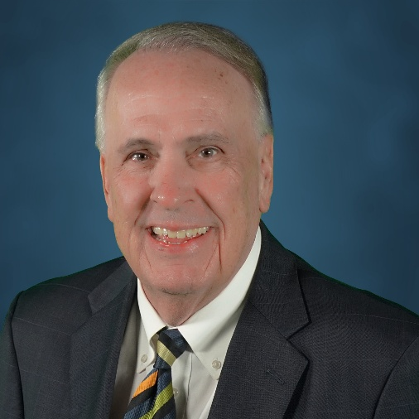
Michael Hunn, CEO, Cal Optima Health, leads the mission and vision of the organization, overseeing its almost 900,000 members and its $4.7B budget - ensuring strong coordination among members, providers, and community partners.
With more than 25 years of executive leadership across hospitals, health systems, and now CalOptima, he brings deep insight into how policy shifts like H.R. 1 may affect healthcare access and the broader safety net here in Orange County.
CalOptima Health is a member of the Orange County Hunger Alliance Steering Committee and is represented by Dr. Kelly Bruno-Nelson, Executive Director of Medi-Cal and CalAIM.
Michael Hunn
Chief Executive Officer
CalOptima Health

Slide 10

With 25 years in the food industry and 11 at CUSD, Kristin is a leader in the “scratch-cooking movement,” replacing processed food with fresh, locally sourced meals for students.
Under her leadership, CUSD became the first district in Southern California and the largest in the nation to earn “Eat Real” certification for advancing healthier, more sustainable school meals.
Kristin is a participating member of the OC Hunger Alliance’s Advocacy Action Working Group.
Kristin L. Hilleman
Director
Food and Nutrition Services
Capistrano Unified School District

Slide 11

Public School Meals Programs
Community Health - Food System Resilience
California’s Universal Meals Program guarantees breakfast and lunch for every TK–12 student — but it still relies on federal reimbursements and direct certification data from SNAP + Medicaid.
H.R. 1 brings cuts and eligibility limits to SNAP/Medicaid. Those programs power the data that determines district funding levels (LCFF) and federal provisions such as CEP (Community Eligibility Provision) rates.
Result: fewer students automatically qualified → less federal reimbursement & more paperwork for families & school meal programs → more strain on state and district budgets.

Slide 12
Public School Meals Programs
Community Health - Food System Resilience
Why It Matters + Resilience Strategy
If direct certification drops, the states reimbursement backfill costs skyrocket, threatening long-term sustainability of universal meals.
Protect Universal Meals funding — advocate for continued state backfill when federal reimbursements decline.
Less reimbursement = weaker local farm-to-school and fresh food initiatives.
Diversify Local Supply Chains — deepen partnerships with local farms and vendors.
Gaps in eligibility data can mask true need countywide.
Strengthen Direct Certification — partner with CalFresh, Medi-Cal, and local agencies to ensure families stay enrolled.
Push for Free/Reduced Meal application completion

Slide 13
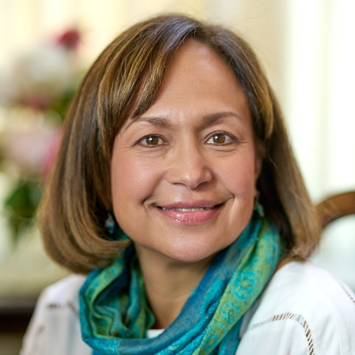
Claudia Bonilla Keller joined Second Harvest Food Bank of Orange County as Chief Mission Officer in 2020 and was appointed CEO in 2022. She leads the organization’s mission to ensure dignified, equitable, and consistent access to nutritious food for all who need it in Orange County.
Claudia served as Chief Program Officer and Health Director at the LA Promise Fund and previously led the American Heart Association’s Los Angeles office, where she was named Executive Director of the Year. Earlier, she spent over 18 years in the fashion industry shaping corporate responsibility and marketing strategies for brands such as St. John, Vans, and Calvin Klein.
She is a founding member of and serves on the Steering Committee of the OC Hunger Alliance.
Claudia Bonilla Keller
Chief Executive Officer
Second Harvest Food Bank of Orange County

Slide 14
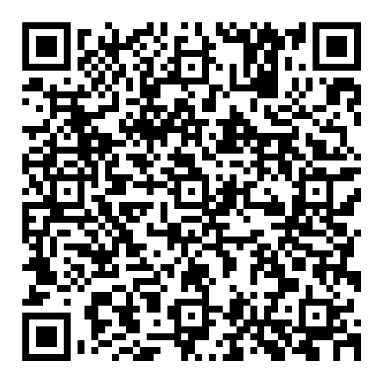
Find Your Local Representatives
Visit at ocvote.maps.arcgis.com/

Slide 15
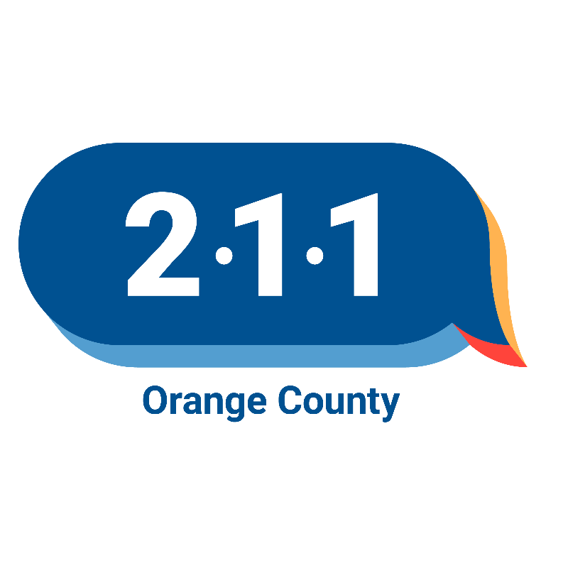

211OC:
A Critical Resource
For residents impacted by the recent CalFresh benefit reductions, OC Hunger Alliance member 211OC remains a critical resource.
Anyone in need can call 2-1-1 or visit 211oc.org to connect with local food, housing, and utility assistance.

Slide 16

Learn More & Get Involved:
Visit OCHungerAlliance.org
Visit at ochungeralliance.org or scan the QR code on screen.
Our current website includes information on the Emergency Food Fund, our founding partners, reports, and related articles.
Stay tuned for our new website, which will feature:
• Updates on events and working group opportunities
• Details on the Community Partner Council launching in 2026

Slide 17
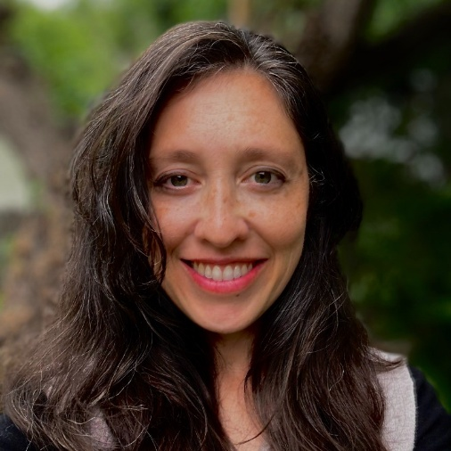

Q&A
Jennie Cottle
Manager, Public Affairs
Orange County United Way
FOR ADDITIONAL QUESTIONS:
Email: stephanie@aboundfoodcare.org
A comprehensive FAQ document summarizing key points and questions from today’s convening will be distributed to all attendees via the email address you used to register.

Slide 18

THANK YOU
FOR MORE INFORMATION:
Email stephanie@aboundfoodcare.org
A recording of today’s convening, along with a comprehensive FAQ document summarizing key discussion points and participant questions will be distrubuted to all attendees via email following the event.

